Slide 1
Probability Distribution
Shirin Shirvani

Slide 2
Discrete distribution
Basics of discrete distributions
Mean and variance of a discrete distribution
Binomial distribution
Poisson distribution and process

Slide 3
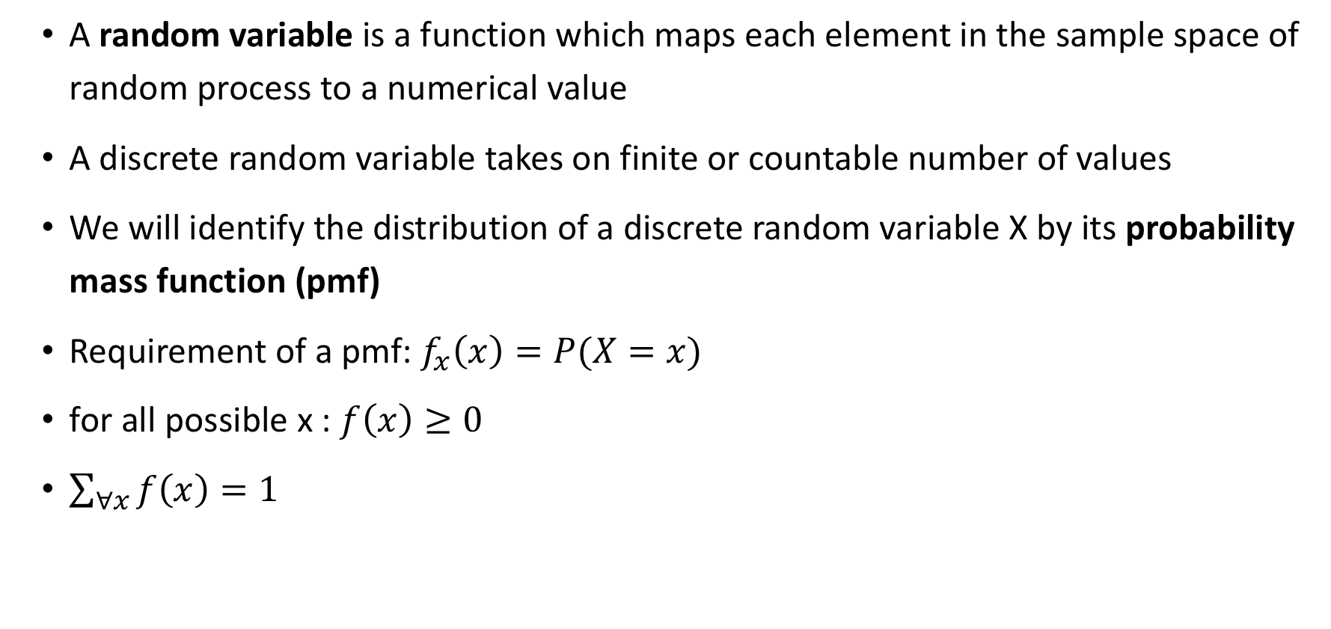
Random Variables
A random variable is a function which maps each element in the sample space of random process to a numerical value
A discrete random variable takes on finite or countable number of values
We will identify the distribution of a discrete random variable X by its probability mass function (pmf)
Requirement of a pmf: $f_{x}\left(x\right)=P(X=x)$
for all possible x : $f\left(x\right)≥0$
$\sum_{∀x}{f\left(x\right)=1}$

Slide 4
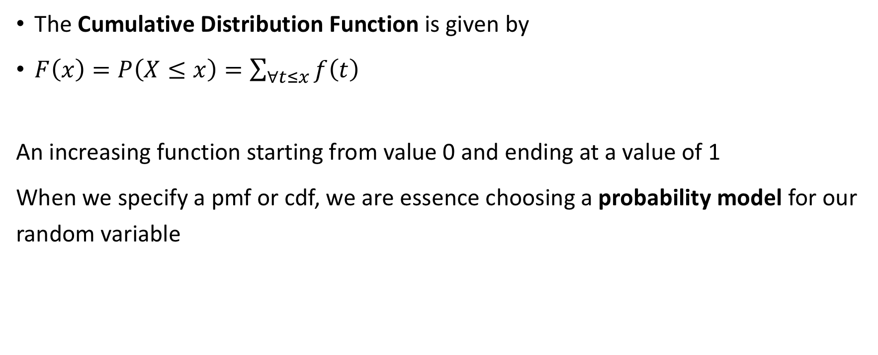
Cumulative Distribution Function
The Cumulative Distribution Function is given by
$F\left(x\right)=P\left(X≤x\right)=\sum_{∀t≤x}{f\left(t\right)}$
An increasing function starting from value 0 and ending at a value of 1
When we specify a pmf or cdf, we are essence choosing a probability model for our random variable

Slide 5
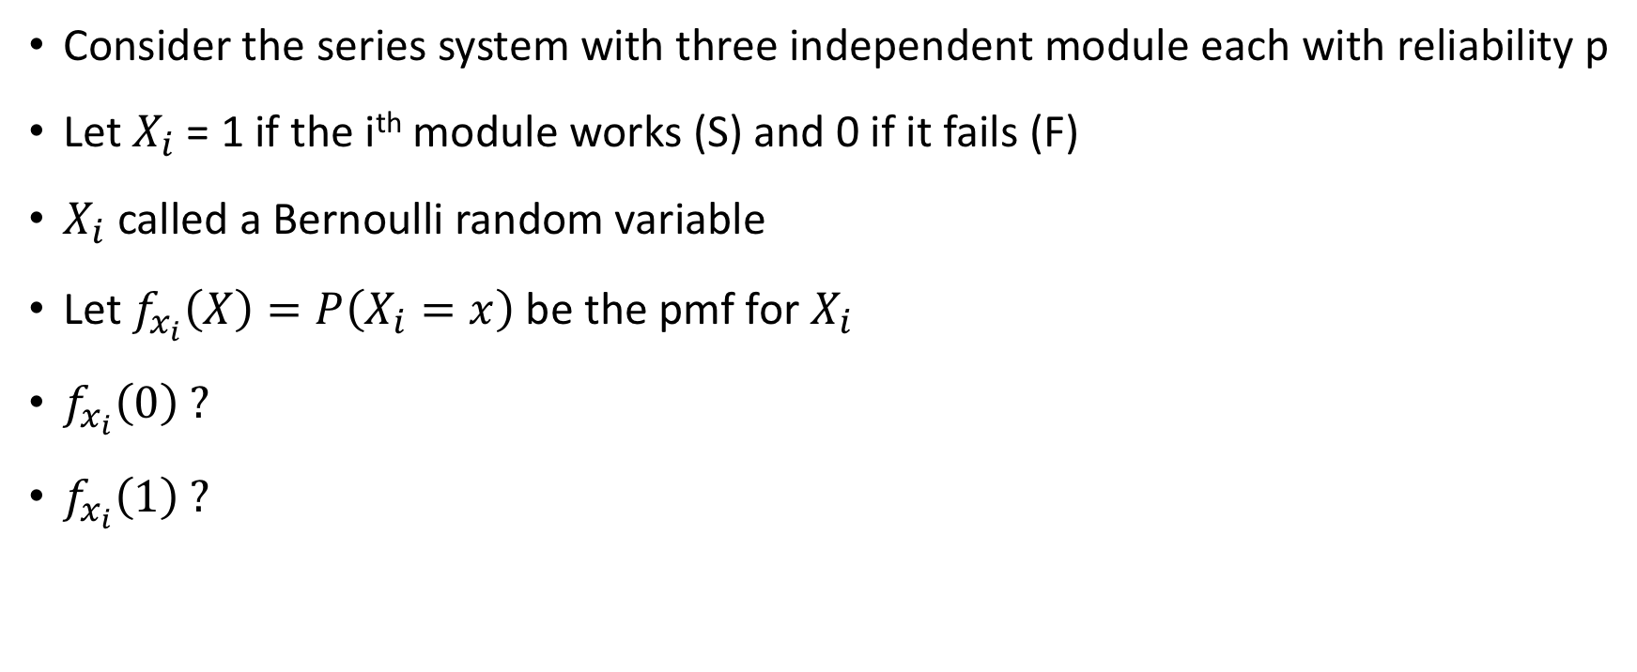
Use case : Reliability example
Consider the series system with three independent module each with reliability p
Let $X_{i}$ = 1 if the i^{th} module works (S) and 0 if it fails (F)
$X_{i}$ called a Bernoulli random variable
Let $f_{x_{i}}\left(X\right)=P\left(X_{i}=x\right)$ be the pmf for $X_{i}$
$f_{x_{i}}\left(0\right) ?$
$f_{x_{i}}\left(1\right) ?$

Slide 6
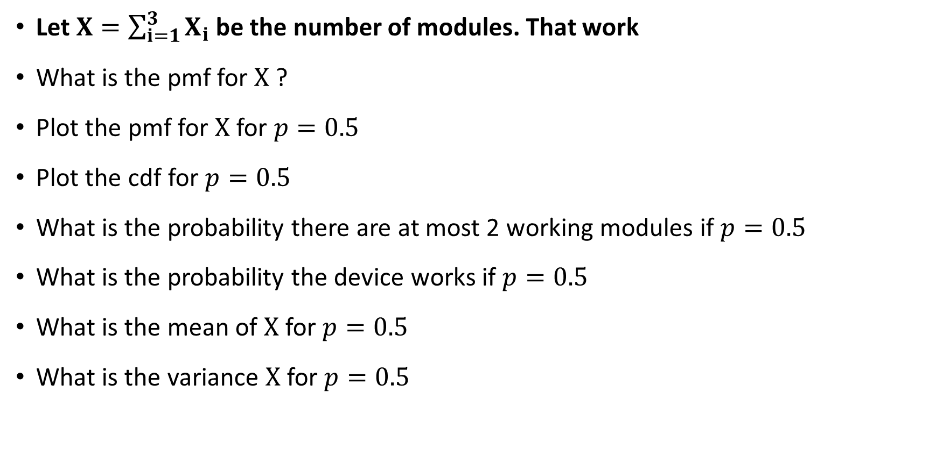
Use case : Reliability example cont.
Let $X=\sum_{i=1}^{3}{X_{i}}$be the number of modules. That work
What is the pmf for $X$ ?
Plot the pmf for $X$ for $p=0.5$
Plot the cdf for $p=0.5$
What is the probability there are at most 2 working modules if $p=0.5$
What is the probability the device works if $p=0.5$
What is the mean of $X$ for $p=0.5$
What is the variance $X$ for $p=0.5$

Slide 7
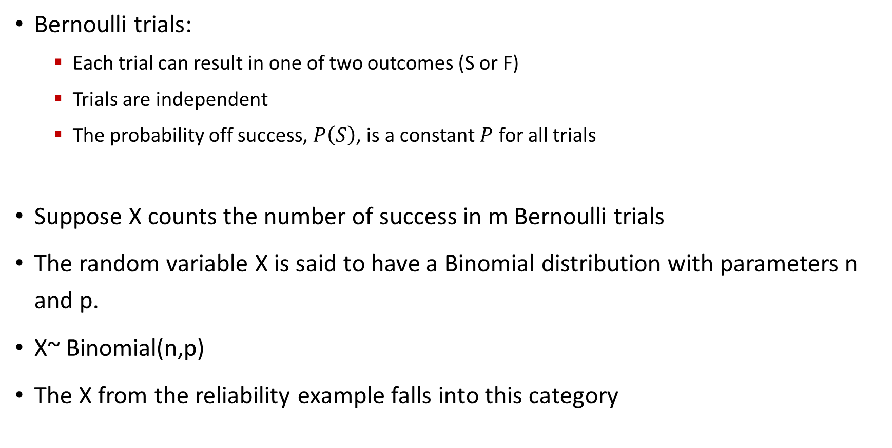
Binomial distribution
Bernoulli trials:
Each trial can result in one of two outcomes (S or F)
Trials are independent
The probability off success, $P\left(S\right)$, is a constant $P$ for all trials
Suppose X counts the number of success in m Bernoulli trials
The random variable X is said to have a Binomial distribution with parameters n and p.
X~ Binomial(n,p)
The X from the reliability example falls into this category

Slide 8
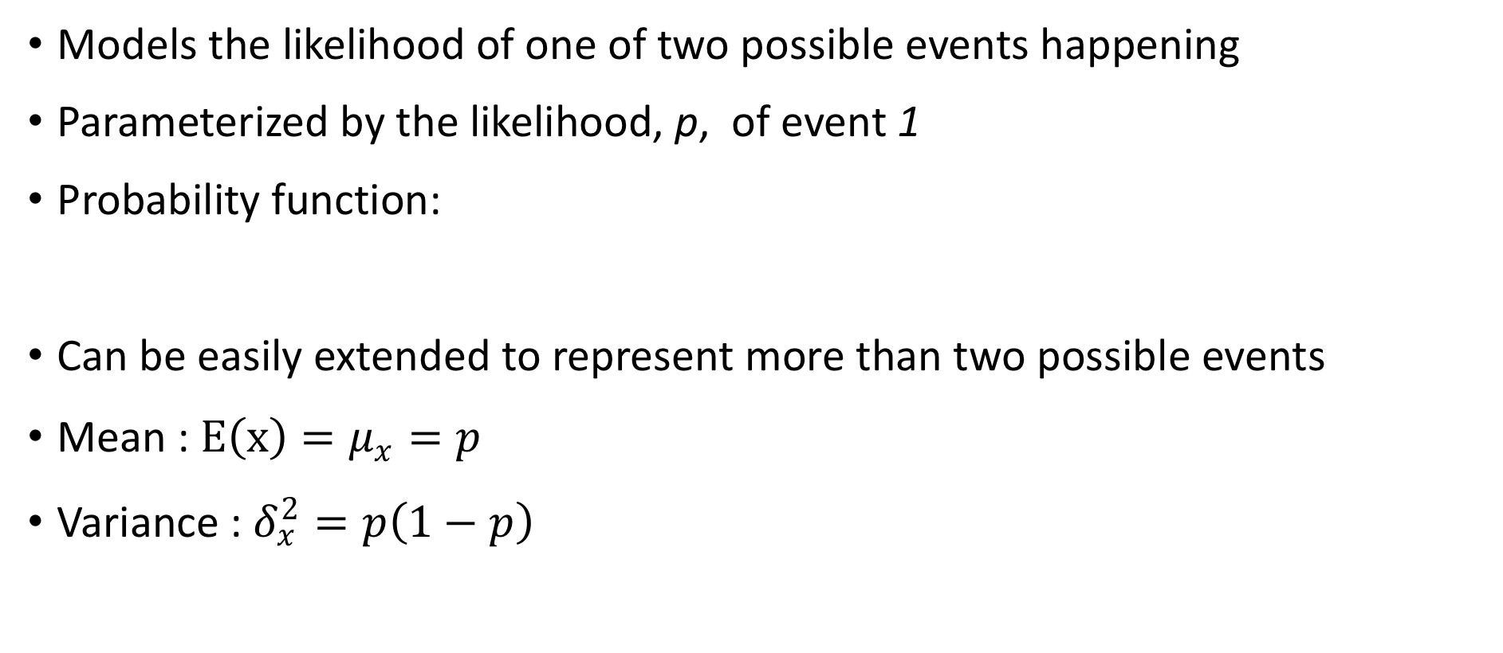
Bernoulli distribution
Models the likelihood of one of two possible events happening
Parameterized by the likelihood, p, of event 1
Probability function:
Can be easily extended to represent more than two possible events
Mean : $E\left(x\right)=μ_{x}=p$
Variance : $δ_{x}^{2}=p\left(1−p\right)$
Notes:
Lottery examples:

Slide 9
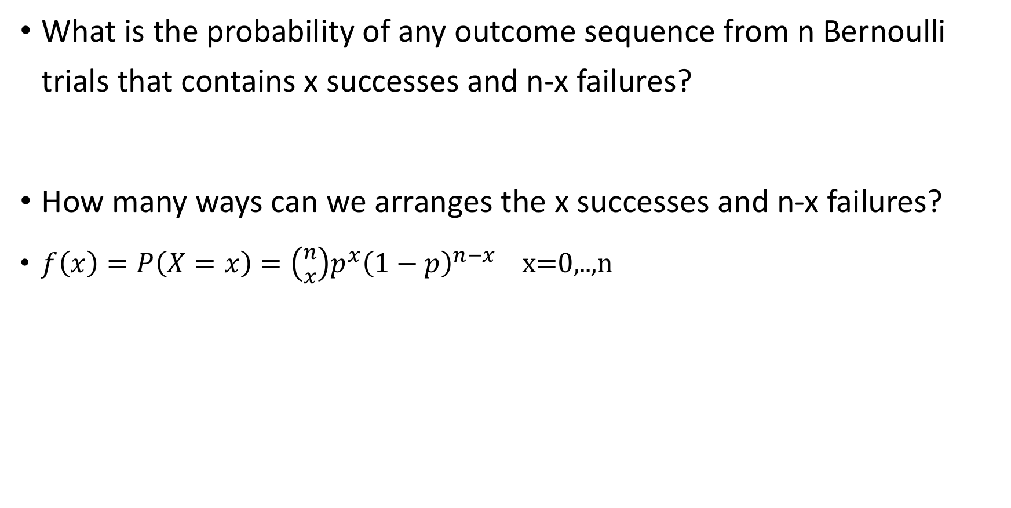
Binomial pmf
What is the probability of any outcome sequence from n Bernoulli trials that contains x successes and n-x failures?
How many ways can we arranges the x successes and n-x failures?
$f\left(x\right)=P\left(X=x\right)=\left({n \atop x}\right){p^{x}\left(1−p\right)}^{n−x} \text{x}\text{=0,..,}\text{n}$

Slide 10

Binomial properties
Recall
${(a+b)}^{n}=\sum_{x=0}^{n}{\left({n \atop x}\right){a^{x}\left(b\right)}^{n−x}}$
$$f\left(x\right)=P\left(X=x\right)=\left({n \atop x}\right){p^{x}\left(1−p\right)}^{n−x} \text{x}\text{=0,..,}\text{n}$$
Mean: $μ_{x}=np$
Variance: $δ_{x}^{2}=np\left(1−p\right)$
$M_{x}\left(t\right)={\left(1−p+pe^{t}\right)}^{n}$

Slide 11
Poisson distribution
The Poisson distribution is used as a probability model for the number of events occurring in an interval where the expected number of events is proportional to the length of the interval
Examples:
# of computer breakdowns per week
# of tweets calls per hour
# of imperfections in a foot long piece of wire
# of bacteria in a culture of a certain area

Slide 12
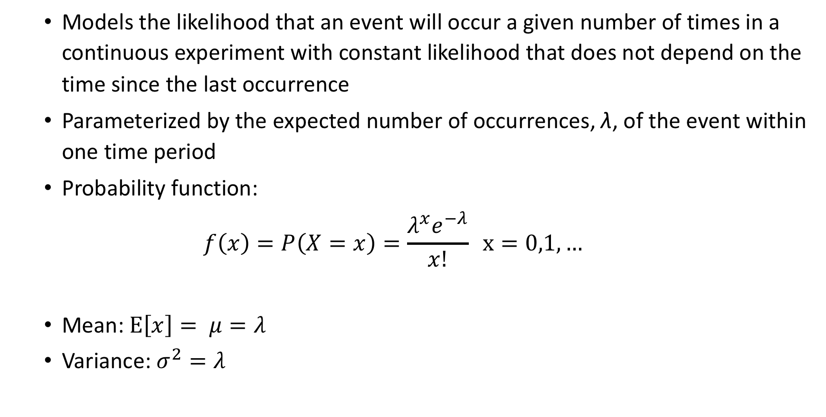
Poisson distribution
Models the likelihood that an event will occur a given number of times in a continuous experiment with constant likelihood that does not depend on the time since the last occurrence
Parameterized by the expected number of occurrences, λ, of the event within one time period
Probability function:
$$f\left(x\right)=P\left(X=x\right)=\frac{λ^{x}e^{−λ}}{x!} x=0,1,…$$
Mean: $E\left[x\right]= μ=λ$
Variance: $σ^{2}=λ$

Slide 13
Poisson example
The software crash once a week on average .
Using a Poisson model, what is the the probability the software will crash at least once in a week?
What is the probability it crash more than 52 times in a year ?
Calculator

Slide 14
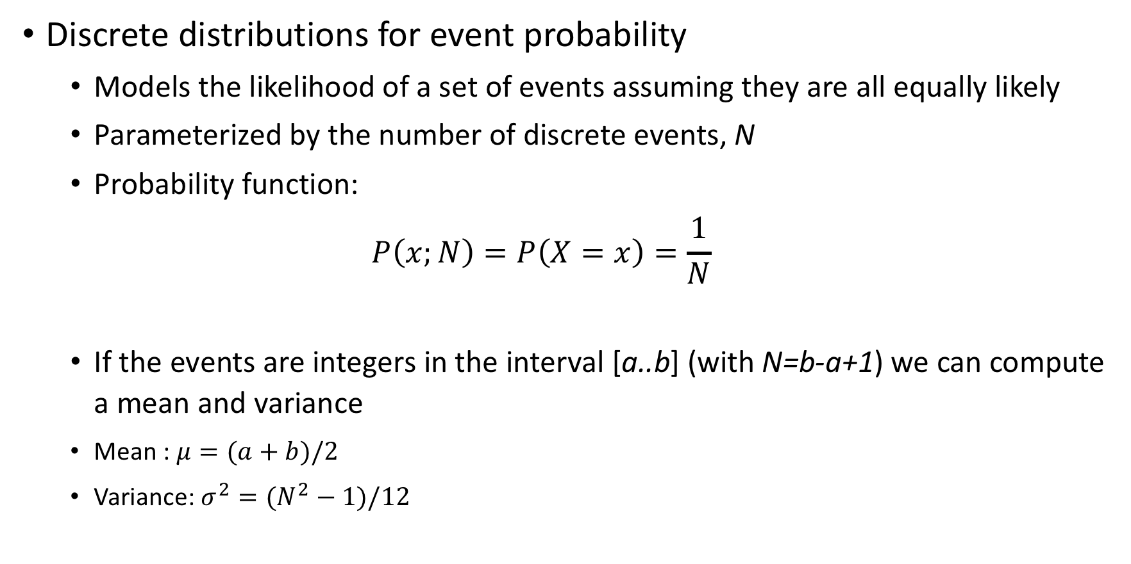
Uniform Discrete distribution
Discrete distributions for event probability
Models the likelihood of a set of events assuming they are all equally likely
Parameterized by the number of discrete events, N
Probability function:
$$P\left(x;N\right)=P\left(X=x\right)=\frac{1}{N}$$
If the events are integers in the interval [a..b] (with N=b-a+1) we can compute a mean and variance
Mean : $μ=(a+b)/2$
Variance: $σ^{2}=(N^{2}−1)/12$

Slide 15
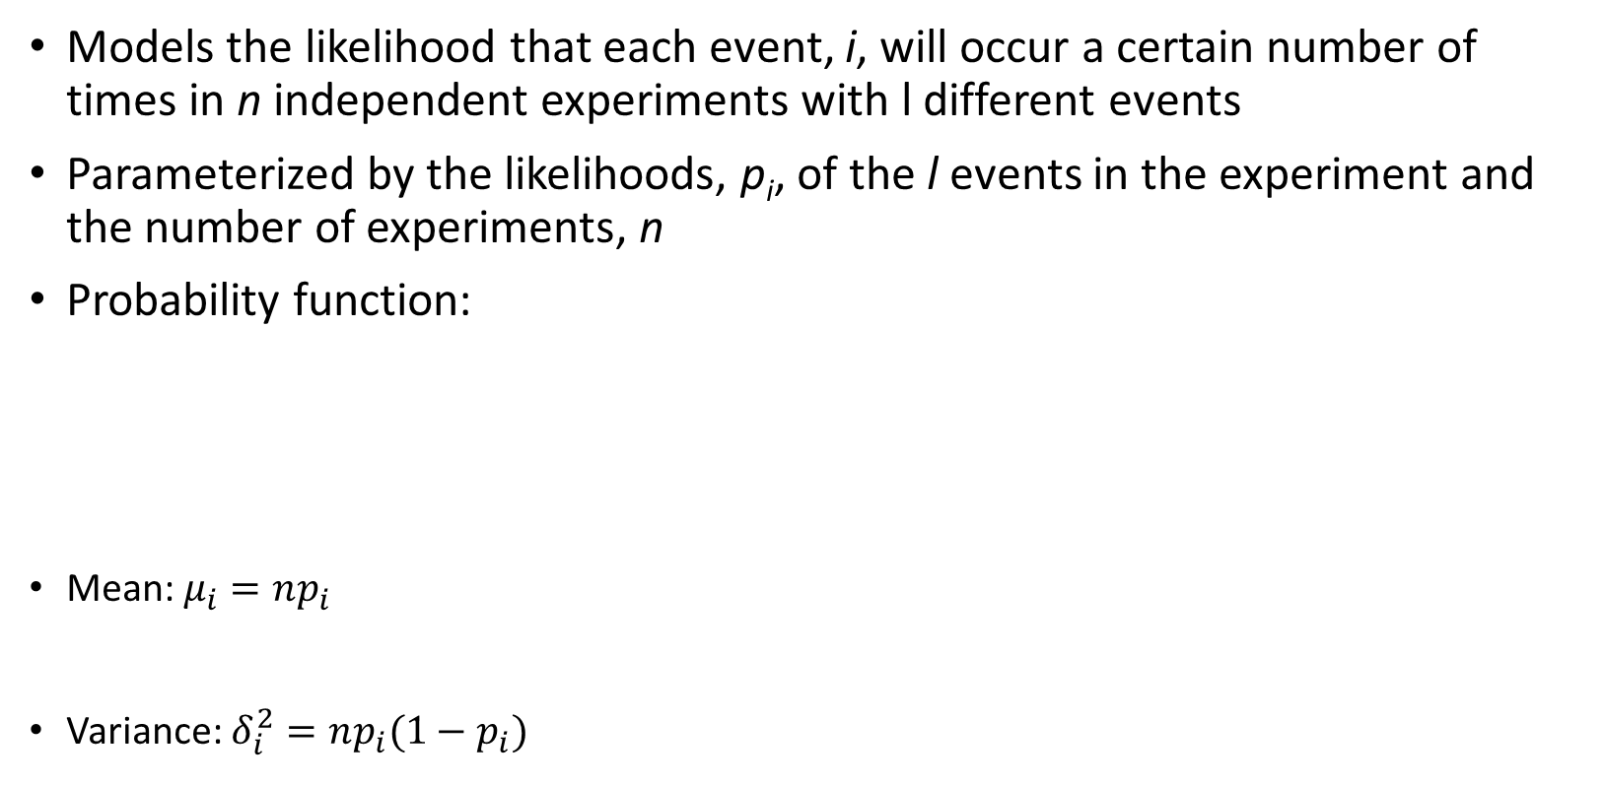
Multinomial distribution
Models the likelihood that each event, i, will occur a certain number of times in n independent experiments with l different events
Parameterized by the likelihoods, p_{i}, of the l events in the experiment and the number of experiments, n
Probability function:
Mean: $μ_{i}=np_{i}$
Variance: $δ_{i}^{2}=np_{i}(1−p_{i})$
Notes:
Lottery examples:

Slide 16
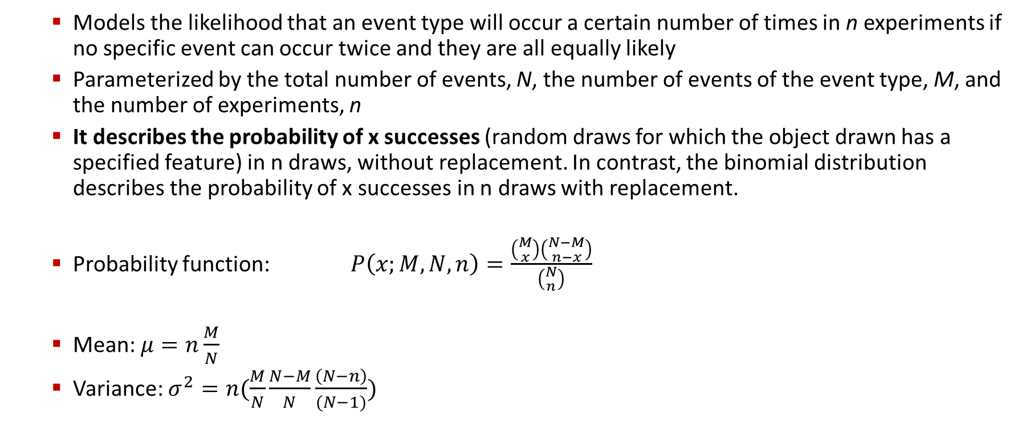
Hypergeometric distribution
Models the likelihood that an event type will occur a certain number of times in n experiments if no specific event can occur twice and they are all equally likely
Parameterized by the total number of events, N, the number of events of the event type, M, and the number of experiments, n
It describes the probability of x successes (random draws for which the object drawn has a specified feature) in n draws, without replacement. In contrast, the binomial distribution describes the probability of x successes in n draws with replacement.
Probability function: $P\left(x;M,N,n\right)=\frac{\left({M \atop x}\right)\left({N−M \atop n−x}\right)}{\left({N \atop n}\right)}$
Mean: $μ=n\frac{M}{N}$
Variance: $σ^{2}=n(\frac{M}{N}\frac{N−M}{N}\frac{\left(N−n\right)}{(N−1)})$
Notes:
Lottery examples:

Slide 17
Hypergeometric card games example
Suppose we randomly select 5 cards without replacement from an ordinary deck of playing cards. What is the probability of getting exactly 2 red cards (i.e., hearts or diamonds)?
Notes:
Lottery examples:

Slide 18
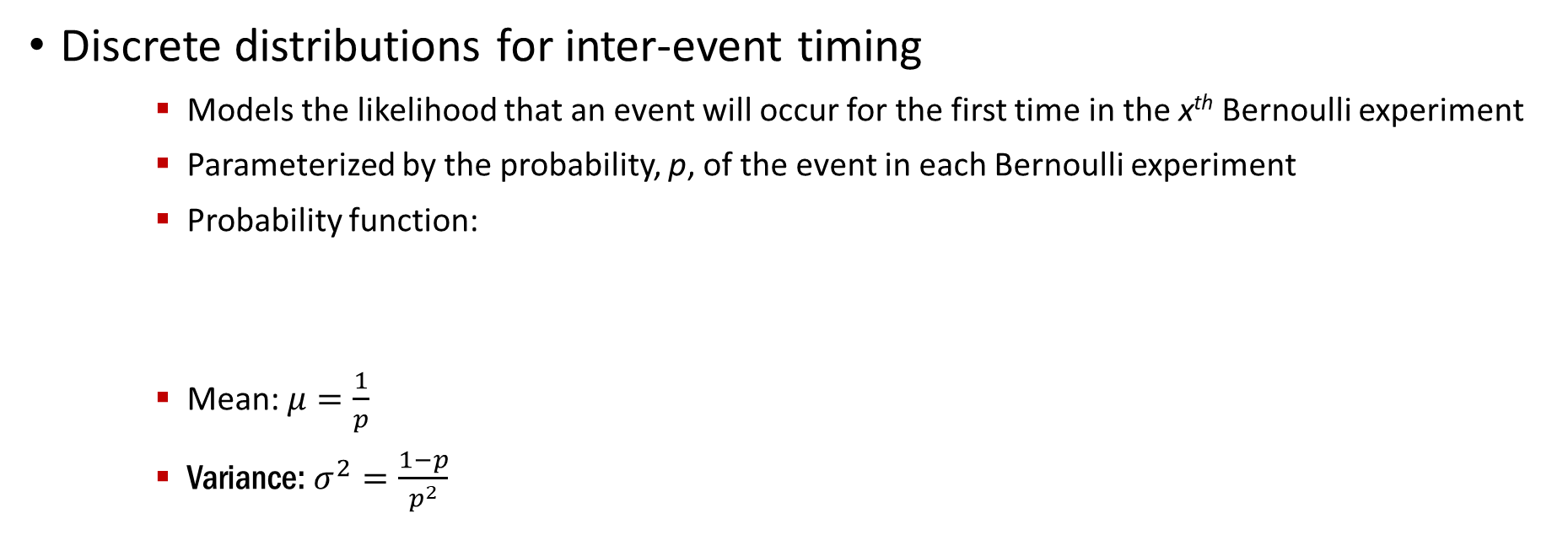
Geometric distribution
Discrete distributions for inter-event timing
Models the likelihood that an event will occur for the first time in the x^{th} Bernoulli experiment
Parameterized by the probability, p, of the event in each Bernoulli experiment
Probability function:
Mean: $μ=\frac{1}{p}$
Variance: $σ^{2}=\frac{1−p}{p^{2}}$
Notes:
Lottery examples:

Slide 19
Continuous distributions
Basics of Continuous distributions
Uniform
Normal
Exponential
Gamma

Slide 20
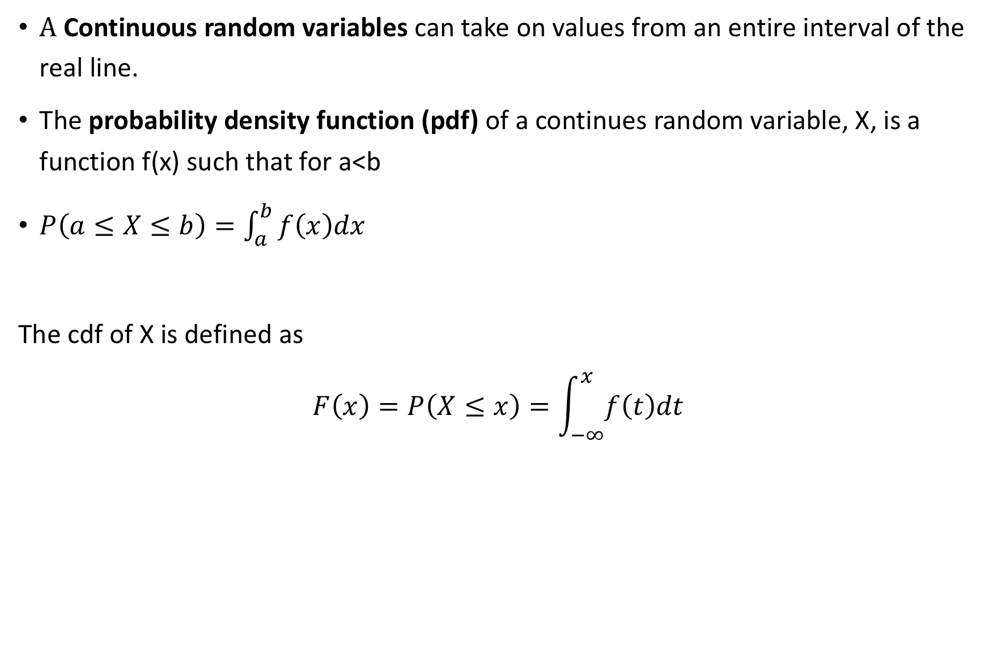
Continuous Random Variables
A Continuous random variables can take on values from an entire interval of the real line.
The probability density function (pdf) of a continues random variable, X, is a function f(x) such that for a<b
$P\left(a≤X≤b\right)=\int_{a}^{b}{f\left(x\right)dx}$
The cdf of X is defined as
$$F\left(x\right)=P\left(X≤x\right)=\int_{−∞}^{x}{f\left(t\right)dt}$$

Slide 21

Some relationships
What is the relationship between f and F?
$P\left(a≤X≤b\right)=F\left(b\right)−F(a)$
$P\left(X=a\right)=P\left(a≤X≤a\right)=F\left(a\right)−F\left(a\right)=0$

Slide 22
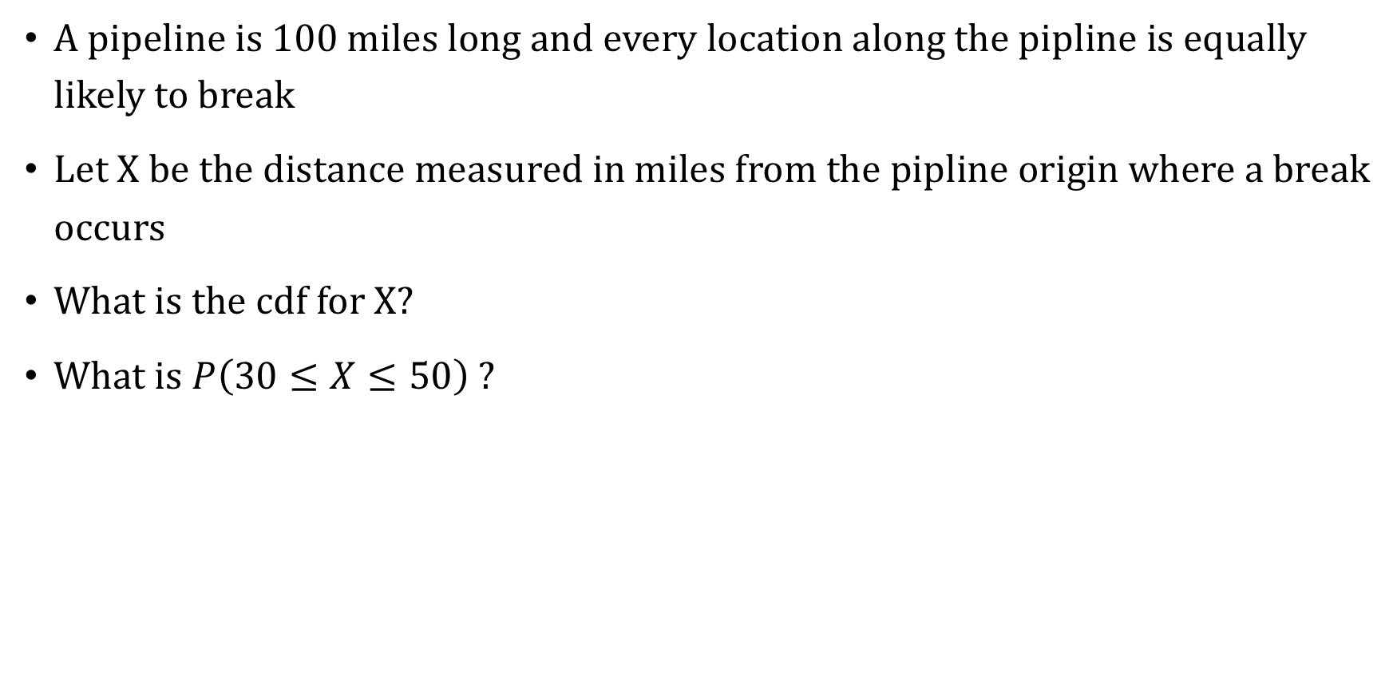
Use case: Pipeline
A pipeline is 100 miles long and every location along the pipline is equally likely to break
Let X be the distance measured in miles from the pipline origin where a break occurs
What is the cdf for X?
What is $P\left(30≤X≤50\right) ?$

Slide 23

Requirements of a pdf
A pdf satisfy the following two requirements:
$f\left(x\right)≥0 ∀x$
$\int_{−∞}^{∞}{f\left(x\right)dx=1}$
Does the pipeline pdf satisfy these requirements?

Slide 24
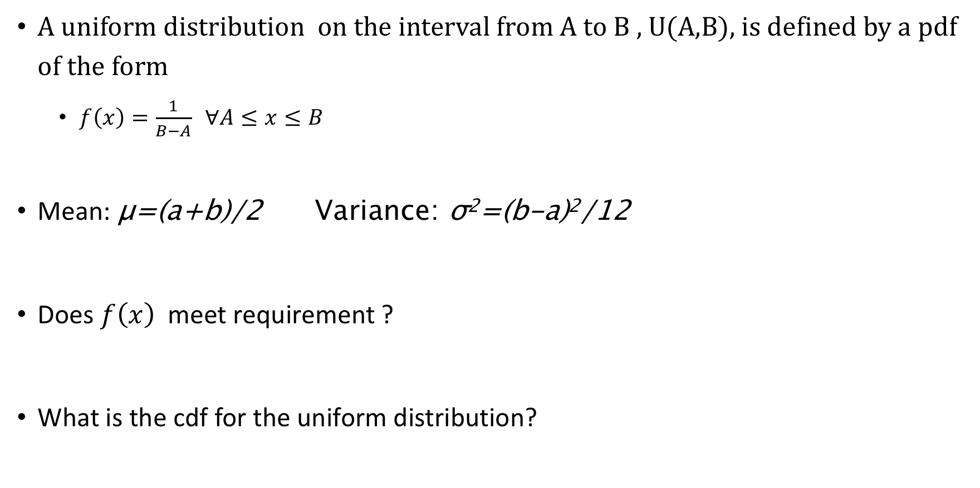
Uniform distribution
A uniform distribution on the interval from A to B , U(A,B), is defined by a pdf of the form
$f\left(x\right)=\frac{1}{B−A} ∀A≤x≤B$
Mean: μ=(a+b)/2 Variance: σ²=(b-a)²/12
Does $f\left(x\right)$ meet requirement ?
What is the cdf for the uniform distribution?

Slide 25

Mean and variance of a cont. random variable
Expected value of $h\left(x\right)$: $E\left(h\left(x\right)\right)=\int_{−∞}^{∞}{h\left(x\right)f\left(x\right)dx}$
Expected value of X: $μ_{x}=E(x)$
Variance of X: $σ_{x}^{2}=E{[\left(x−μ_{x}\right)}^{2}]$
$σ_{x}^{2}=E\left(x^{2} \right)−μ_{x}^{2}$
Moment generating function for x : $M_{x}(t)=E(e^{tx})$
$M_{x }^{′}\left(0\right)=μ_{x},M_{x }^{′′}\left(0\right)= E(X^{2})$

Slide 26
Back to uniform
What is the mean of a U(0,1) ?
What is the variance of a U(0,1) ?

Slide 27
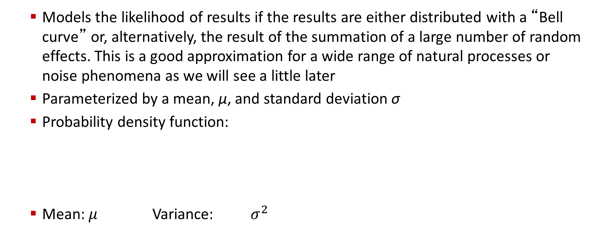
Normal distribution
Models the likelihood of results if the results are either distributed with a “Bell curve” or, alternatively, the result of the summation of a large number of random effects. This is a good approximation for a wide range of natural processes or noise phenomena as we will see a little later
Parameterized by a mean, μ, and standard deviation σ
Probability density function:
Mean: $μ$ Variance: $σ^{2}$
Notes:
Lottery examples:

Slide 28
Weight gain example
The weight gain associated with an antidepressant is normally distributed with a mean of 6 lbs and a standard deviation of 3 lbs
What is the probability of weight gain?
What is the probability of gaining between 0 and 12 lbs?

Slide 29
Normal Distributions
Continuous distributions for event frequency
Models the number of times an event happens in a very large (infinite) number of experiments
Parameterized by a mean, μ, and standard deviation σ
Probability density function:
Notes:
Lottery examples:

Slide 30
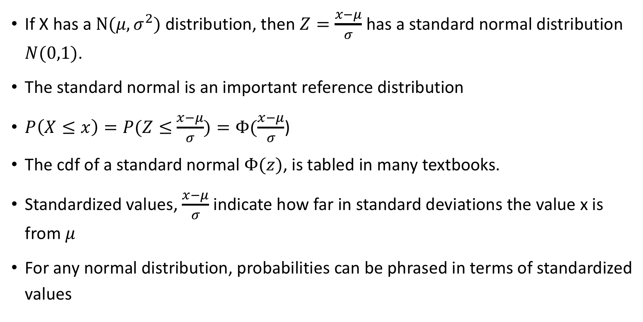
Standard normal distribution
If X has a $N(μ,σ^{2})$ distribution, then $Z=\frac{x−μ}{σ}$ has a standard normal distribution $N(0,1)$.
The standard normal is an important reference distribution
$P\left(X≤x\right)=P(Z≤$ $\frac{x−μ}{σ})=Φ(\frac{x−μ}{σ}$)
The cdf of a standard normal $Φ(z)$, is tabled in many textbooks.
Standardized values, $\frac{x−μ}{σ}$ indicate how far in standard deviations the value x is from $μ$
For any normal distribution, probabilities can be phrased in terms of standardized values

Slide 31
Empirical rule
What is the probability?
A normal falls within one standard deviation of the mean?
A normal falls within two standard deviation of the mean?
A normal falls within three standard deviation of the mean?

Slide 32

Back to the weight gain example
Recall $μ=6, σ=3$
Using the empirical rule. Answer the following questions:
What is the probability of weight loss?
What is the probability of a weight gain between 0 and 12 pounds?

Slide 33
Do my data look normal : Normal Approximation
Normal Approximation
Normal approximation to Binomial
Normal approximation to Poisson

Slide 34
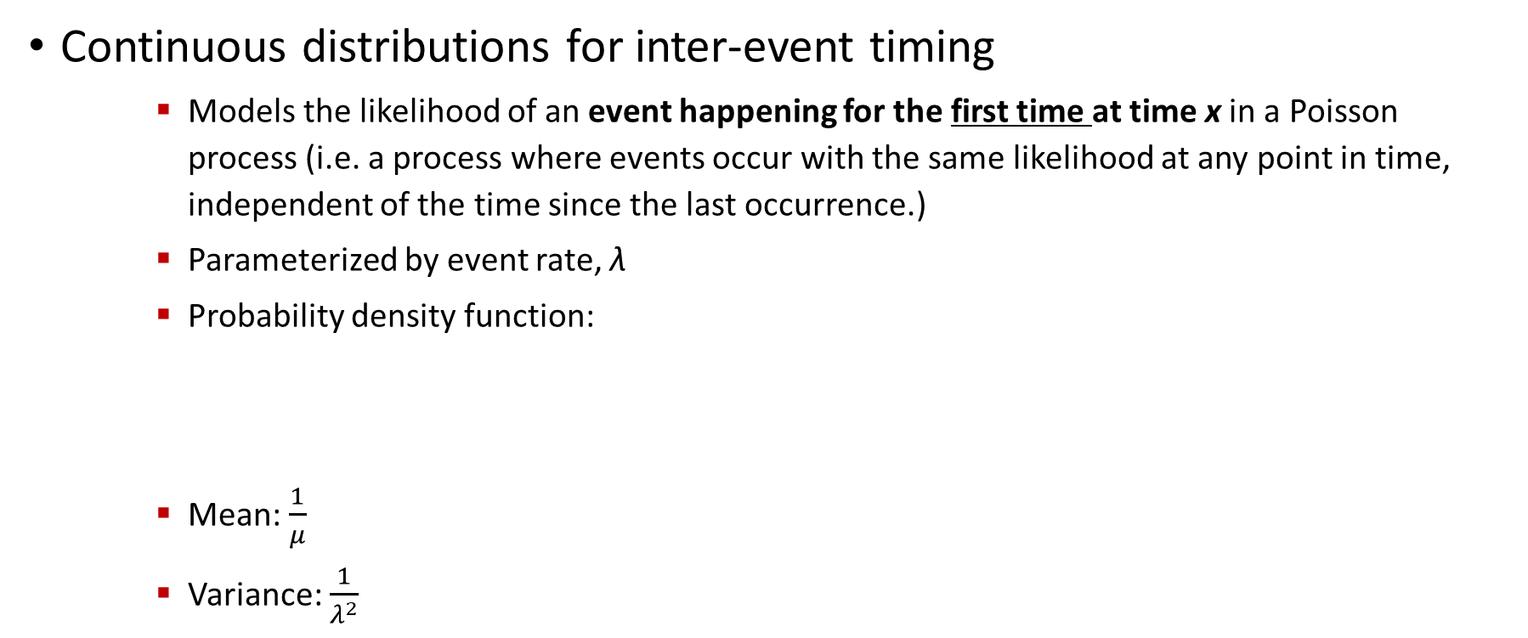
Exponential distribution
Continuous distributions for inter-event timing
Models the likelihood of an event happening for the first time at time x in a Poisson process (i.e. a process where events occur with the same likelihood at any point in time, independent of the time since the last occurrence.)
Parameterized by event rate, λ
Probability density function:
Mean: $\frac{1}{μ}$
Variance: $\frac{1}{λ^{2}}$
Notes:
Lottery examples:

Slide 35

Gamma distribution
The gamma distribution $Γ(α,β)$ is defined by the following pdf
$f\left(x\right)= \frac{1}{β^{α}Γ\left(α\right)}x^{α−1}e^{\frac{−x}{β}} x≥0, α>0, β>0$
Where $Γ\left(α\right)=\int_{0}^{∞}{x^{α−1}e^{−x}dx for α>0}$
Properties of the gamma function $Γ\left(α\right)$
For $α>1,Γ\left(α\right)=\left(α−1\right)Γ\left(α−1\right)$
If $\left(α\right)$ is a positive integer, $Γ\left(α\right)=\left(α−1\right)!$
$Γ\left(\frac{1}{2}\right)=\sqrt{π}$

Slide 36
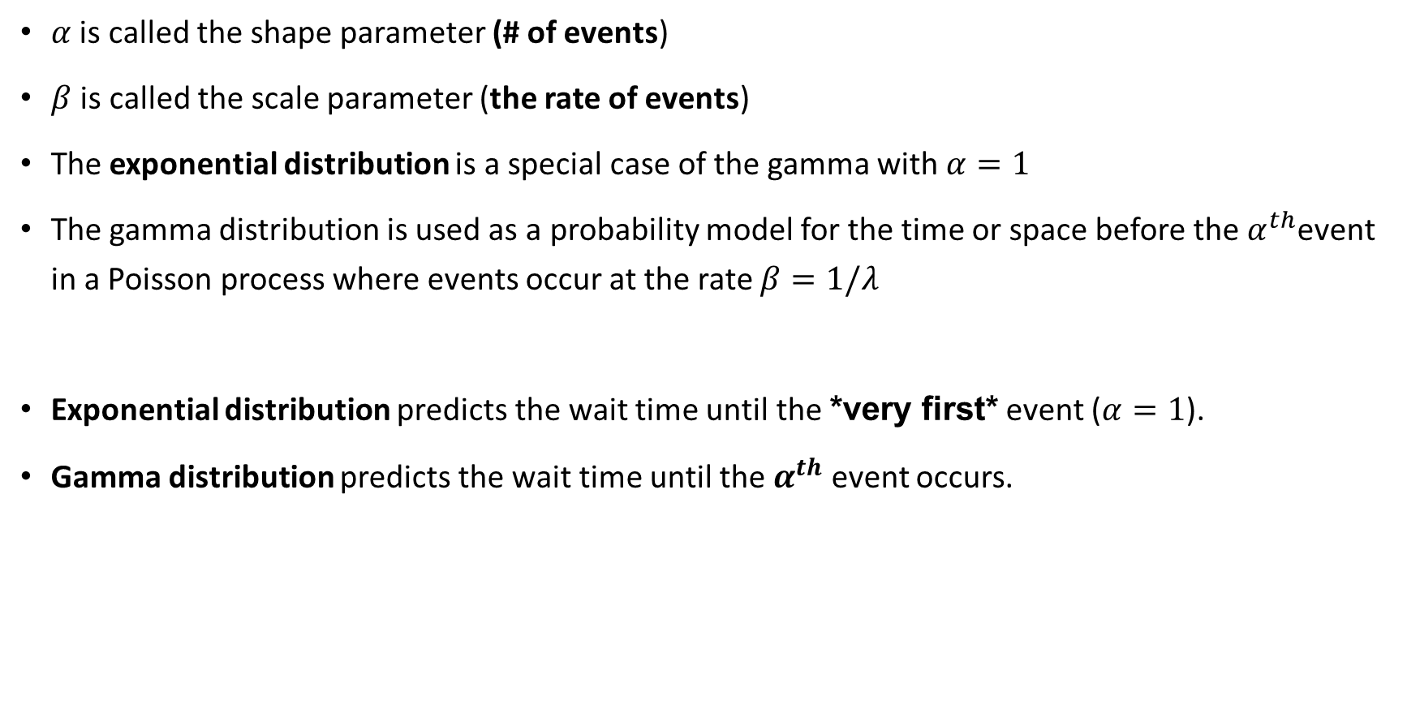
More on the Gamma distribution
$α$ is called the shape parameter (# of events)
$β$ is called the scale parameter (the rate of events)
The exponential distribution is a special case of the gamma with $α=1$
The gamma distribution is used as a probability model for the time or space before the $α^{th}$event in a Poisson process where events occur at the rate $β=1/λ$
Exponential distribution predicts the wait time until the *very first* event ($α=1$).
Gamma distribution predicts the wait time until the $α^{th}$ event occurs.

Slide 37

Properties of the Gamma distribution
Is it a valid pdf?
Show $M_{x}\left(t\right)=1/\left(1−βt\right)^α$
Show $μ=αβ$

Slide 38
Applications of Gamma distribution
A range of disciplines including queuing models, climatology, and financial services. Examples of events that may be modeled by gamma distribution include:
The amount of rainfall accumulated in a reservoir
The size of loan defaults or aggregate insurance claims
The flow of items through manufacturing and distribution processes
The load on web servers
The many and varied forms of telecom exchange

Slide 39
Back to the clunker software
Recall that my software crash once a week on average.
If the breakdowns occur as events in a Poisson process. Then what is the probability less than a week passes before my first breakdown?

Slide 40
Pipe Example
Defects along a piece of pipe occur as events in a passion process with an average of 2 defects every 10 feet)
What is the probability that the third defect will occur at least 20 feet from the beginning of the pipe?

Slide 41


Example gamma distribution
Suppose you are fishing and you expect to get a fish once every 1/2 hour.
Compute the probability that you will have to wait between 2 to 4 hours before you catch 4 fish.
One fish every 1/2 hour means we would expect to get $α$ = 1 / 0.5 = 2 fish every hour on average.
Using $α=2$ and $β=4$, we can compute this as follows:

Slide 42
Hypergeometric to Binomial
If the population is large and the number of samples drawn is small, then the Hypergeometric distribution can be approximated by the Binomial distribution.
p=M/N

Slide 43
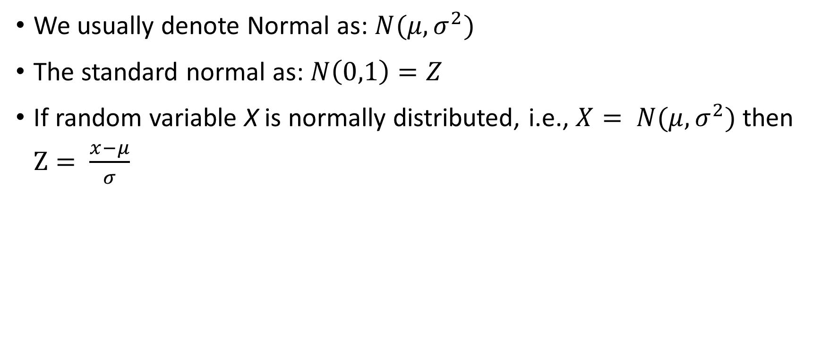
Normal to Standard Normal
We usually denote Normal as: $N(μ,σ^{2})$
The standard normal as: $N\left(0,1\right)=Z$
If random variable X is normally distributed, i.e., $X= N(μ,σ^{2})$ then $Z= \frac{x−μ}{σ}$
Notes:
Show proof
However, even the standard normal’s cdf is difficult to calculate. Thus we use tables.

Slide 44
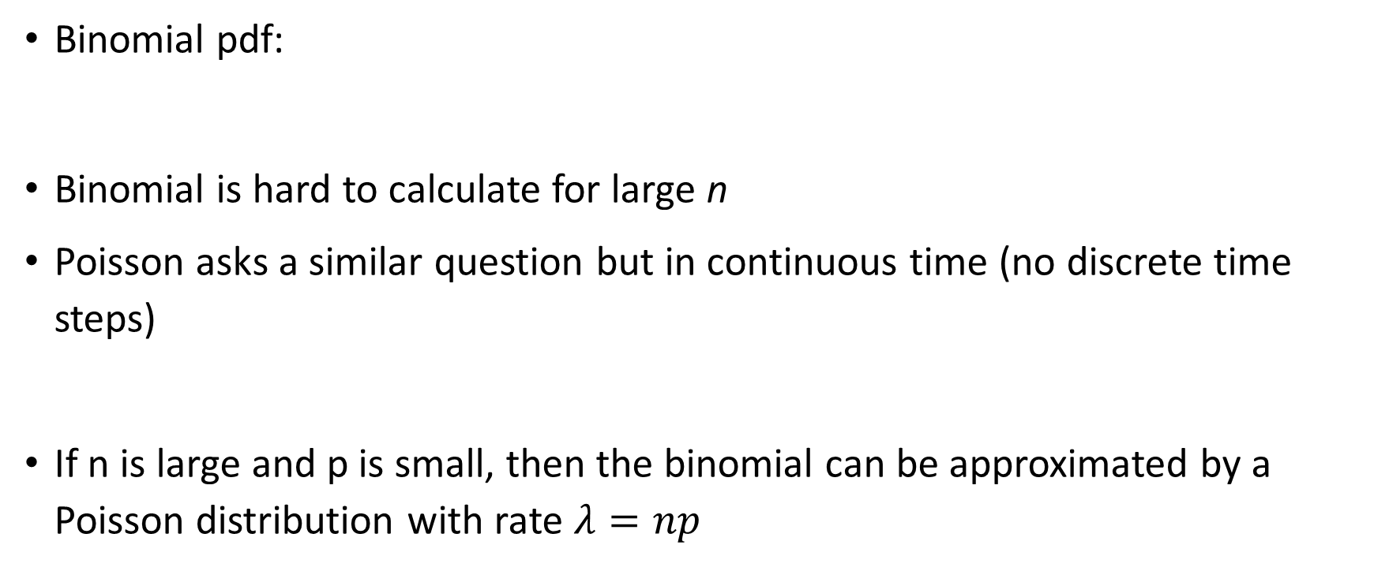
Binomial to Poisson
Binomial pdf:
Binomial is hard to calculate for large n
Poisson asks a similar question but in continuous time (no discrete time steps)
If n is large and p is small, then the binomial can be approximated by a Poisson distribution with rate $λ=np$
Notes:
Show proof
However, even the standard normal’s cdf is difficult to calculate. Thus we use tables.

Slide 45
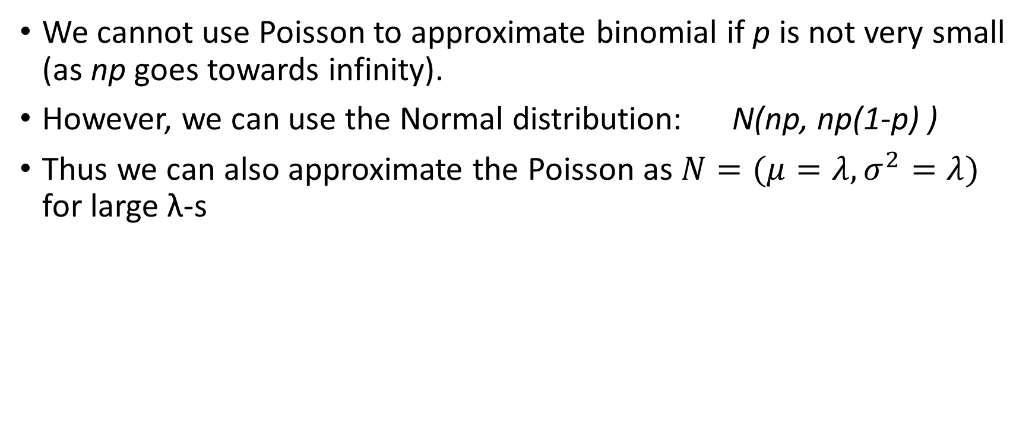
Binomial to Normal
We cannot use Poisson to approximate binomial if p is not very small (as np goes towards infinity).
However, we can use the Normal distribution: N(np, np(1-p) )
Thus we can also approximate the Poisson as $N=(μ=λ,σ^{2}=λ)$ for large λ-s
Notes:
Remember, the Normal models the result of the summation of a large number of random effects.

Slide 46
Distributions
If a function is always positive and converges to 0, , can we make it into a pdf ?
E.g. between 1 and ∞ and 0 otherwise.
No
There are functions of this type that do not represent probability distributions
Notes:
The primitive functions for a/x is a*ln(x) which does not have a finite value in inf, thus its integral is inf.
Thus the speed of converegence matters.

Slide 47
Heavy Tailed Distributions
How about “quicker” convergence:
f(x)=a/x² between 1 and ∞ and 0 otherwise.
Can this be made into a pdf
Yes
What is its mean
Infinite – the tail is too heavy
i.e. there are distributions that do not have numeric mean
What is its variance
Infinite
Notes:
The cdf is a*x^-1/1, i.e., a/x. Thus [a/x] (1,inf) = a, thus a=1
Thus it is 1/x^2 is a pdf on [1,inf]
How about it’s mean? It is the indefinite integral of0 1/x^2 * x which is the integral of 1/x. Thus ln(x). Again this is infinite.
This is a rod that cannot be balanced. It’s tail is so heavy.
Thus variance must be infinite.

Slide 48
Lower Polynomial Powers
How about even “quicker” convergence:
f(x)=a/x³ between 1 and ∞ and 0 otherwise.
Can this be made into a pdf
Yes
What is its mean
2
What is its variance
Infinite
i.e. there are distributions that have a numeric mean but do no numeric variance
Notes:
The cdf is a*x^-1/1, i.e., a/x. Thus [a/x] (1,inf) = a, thus a=1
Thus it is 1/x^2 is a pdf on [1,inf]
How about it’s mean? It is the indefinite integral of0 1/x^2 * x which is the integral of 1/x. Thus ln(x). Again this is infinite.
This is a rod that cannot be balanced. It’s tail is so heavy.
Thus variance must be infinite.

Slide 49
Lower Polynomial Powers
How about even “quicker” convergence:
f(x)=a/x⁴ between 1 and ∞ and 0 otherwise.
Can this be made into a pdf
Yes
Does it have a finite mean
Yes
Does it have a finite variance
Yes
Notes:
The cdf is a*x^-1/1, i.e., a/x. Thus [a/x] (1,inf) = a, thus a=1
Thus it is 1/x^2 is a pdf on [1,inf]
How about it’s mean? It is the indefinite integral of0 1/x^2 * x which is the integral of 1/x. Thus ln(x). Again this is infinite.
This is a rod that cannot be balanced. It’s tail is so heavy.
Thus variance must be infinite.

Slide 50
Pareto Distribution
The Pareto distribution has two parameters, a shape parameter α and a minimum x_{m}
Models many social and physical phenomena
Wealth distribution (80-20 rule), heard drive failures, daily maximum rainfalls, size of fires, etc.
Probability density
Cumulative density function
Notes:
Note, this is just the function from our previous examples!
The mean is only given if alpha>1. The variance is only given if alpha>2. In most interesting cases alpha is between 1 and 2 unfortunately.
Tell them to look up the exact formulas for mean and variance in wikipedia, although they should really be able to calculate them).
Pareto originally used this distribution to describe the allocation of wealth among individuals since it seemed to show rather well the way that a larger portion of the wealth of any society is owned by a smaller percentage of the people in that society. He also used it to describe distribution of income.^{[2]} This idea is sometimes expressed more simply as the Pareto principle or the "80-20 rule" which says that 20% of the population controls 80% of the wealth.^{[3]}
Applications:
Computer traffic after the introduction of http.
The sizes of human settlements (few cities, many hamlets/villages)^{[4]}
File size distribution of Internet traffic which uses the TCP protocol (many smaller files, few larger ones)^{[4]}
Hard disk drive error rates^{[5]}
Clusters of Bose–Einstein condensate near absolute zero^{[citation needed]}
The values of oil reserves in oil fields (a few large fields, many small fields)^{[4]}
The length distribution in jobs assigned supercomputers (a few large ones, many small ones)^{[citation needed]}
The standardized price returns on individual stocks ^{[4]}
Fitted cumulative Pareto distribution to maximum one-day rainfalls
Sizes of sand particles ^{[4]}
Sizes of meteorites
Numbers of species per genus (There is subjectivity involved: The tendency to divide a genus into two or more increases with the number of species in it)^{[citation needed]}
Areas burnt in forest fires

Slide 51
Pareto Distribution
The Pareto distribution is heavy tailed for some parameter settings
Infinite mean for α≤1
Infinite variance for α≤2
For many interesting problems the parameters fall into this region
E.g. 80-20 rule has α≈1.161
Heavy tailed distributions exist and model existing problems
Has implications on sums and products of functions and the central limit theorem
Notes:
Note, this is just the function from our previous examples!
The mean is only given if alpha>1. The variance is only given if alpha>2. In most interesting cases alpha is between 1 and 2 unfortunately.
Tell them to look up the exact formulas for mean and variance in wikipedia, although they should really be able to calculate them).
Pareto originally used this distribution to describe the allocation of wealth among individuals since it seemed to show rather well the way that a larger portion of the wealth of any society is owned by a smaller percentage of the people in that society. He also used it to describe distribution of income.^{[2]} This idea is sometimes expressed more simply as the Pareto principle or the "80-20 rule" which says that 20% of the population controls 80% of the wealth.^{[3]}
Applications:
Computer traffic after the introduction of http.
The sizes of human settlements (few cities, many hamlets/villages)^{[4]}
File size distribution of Internet traffic which uses the TCP protocol (many smaller files, few larger ones)^{[4]}
Hard disk drive error rates^{[5]}
Clusters of Bose–Einstein condensate near absolute zero^{[citation needed]}
The values of oil reserves in oil fields (a few large fields, many small fields)^{[4]}
The length distribution in jobs assigned supercomputers (a few large ones, many small ones)^{[citation needed]}
The standardized price returns on individual stocks ^{[4]}
Fitted cumulative Pareto distribution to maximum one-day rainfalls
Sizes of sand particles ^{[4]}
Sizes of meteorites
Numbers of species per genus (There is subjectivity involved: The tendency to divide a genus into two or more increases with the number of species in it)^{[citation needed]}
Areas burnt in forest fires

Slide 52
Moments
Moments represent important aspects of the distribution and can be used to characterize mean, variance, etc.
In some cases the standard definition is difficult to compute
Moment generating function can sometimes help
Notes:
Lottery examples:

Slide 53
Moment Generating Function
The moment generating function for a random variable X is defined as
The r^{th} moment of X around 0 can then be computed as:
Note that sometimes this can not be computed since the limit might not be defined
Notes:
Lottery examples:

Slide 54
Moment Generating Function
The moment generating function allows to compute, e.g., the mean and the variance
Mean:
Variance:
Notes:
Lottery examples:

Slide 55
Example: Poisson Distribution
Probability mass function
Moment generating function
Mean
Variance
Notes:
Lottery examples:

Slide 56
Multivariate Distributions
Multivariate distributions sometimes arise when combining the outcomes of multiple random variables
Sometimes we are interested of the joint effect of multiple random variables
Distribution of the product of two random variables
Distribution of the joint additive effect of multiple variables
Notes:
Lottery examples:

Slide 57
Multivariate Distributions
For some operations combining multiple variables we can determine the moments of the distribution relatively easily
Usually assumptions made about random variables
Independently distributed
Moments of the distributions of the individual variables are known
If variables are not independent we have to use conditional distributions and the laws of probability
Notes:
Lottery examples:

